Slide 1
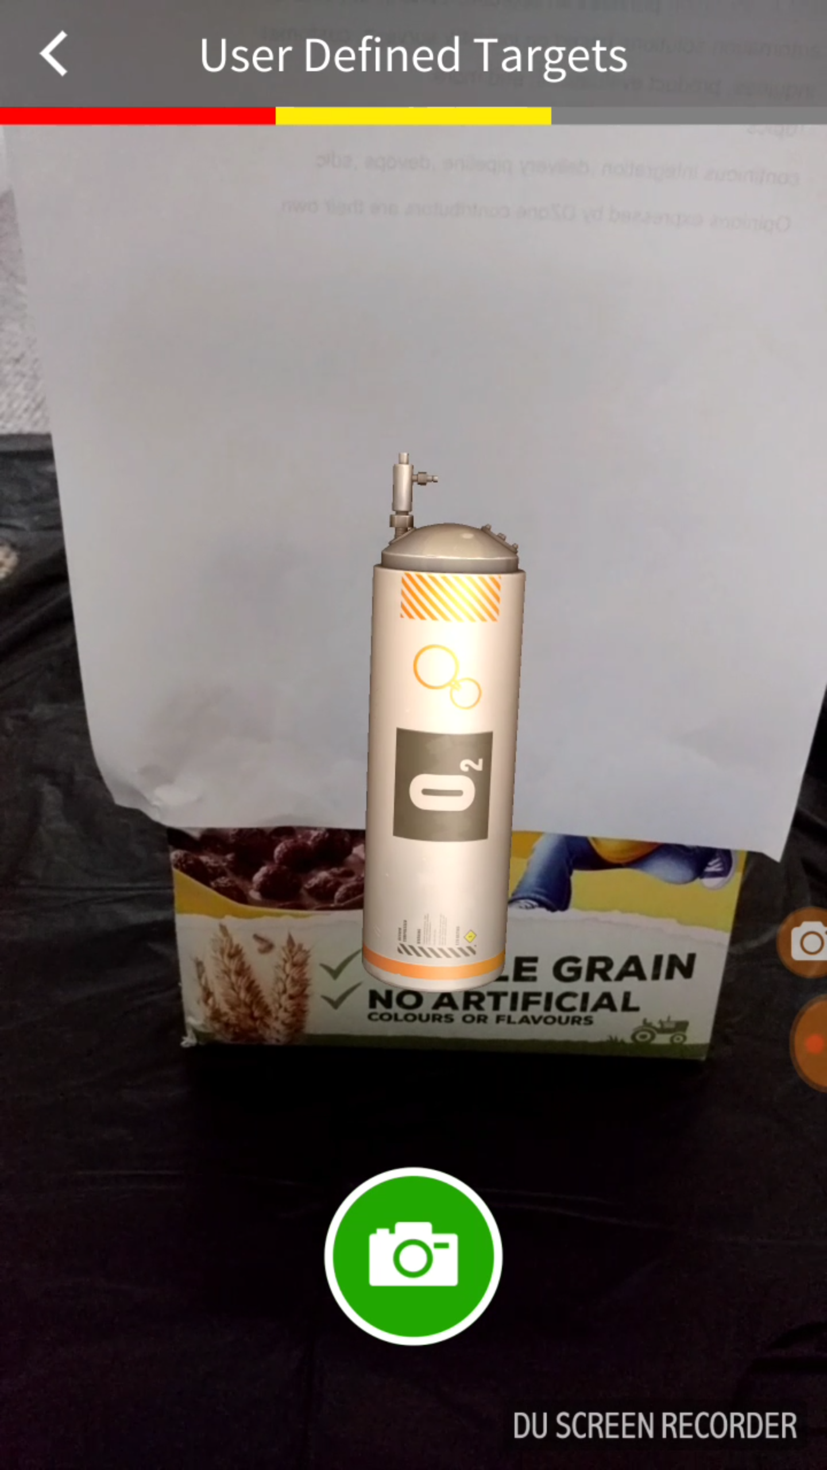
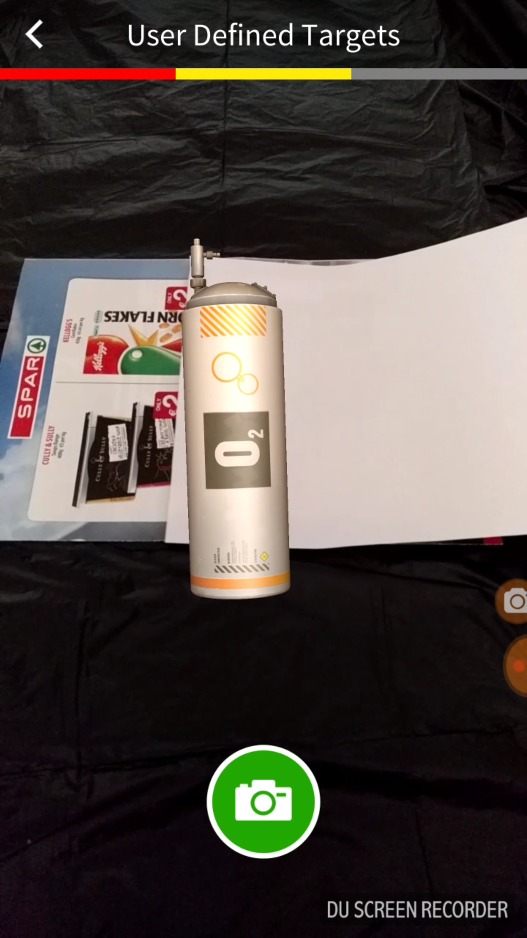
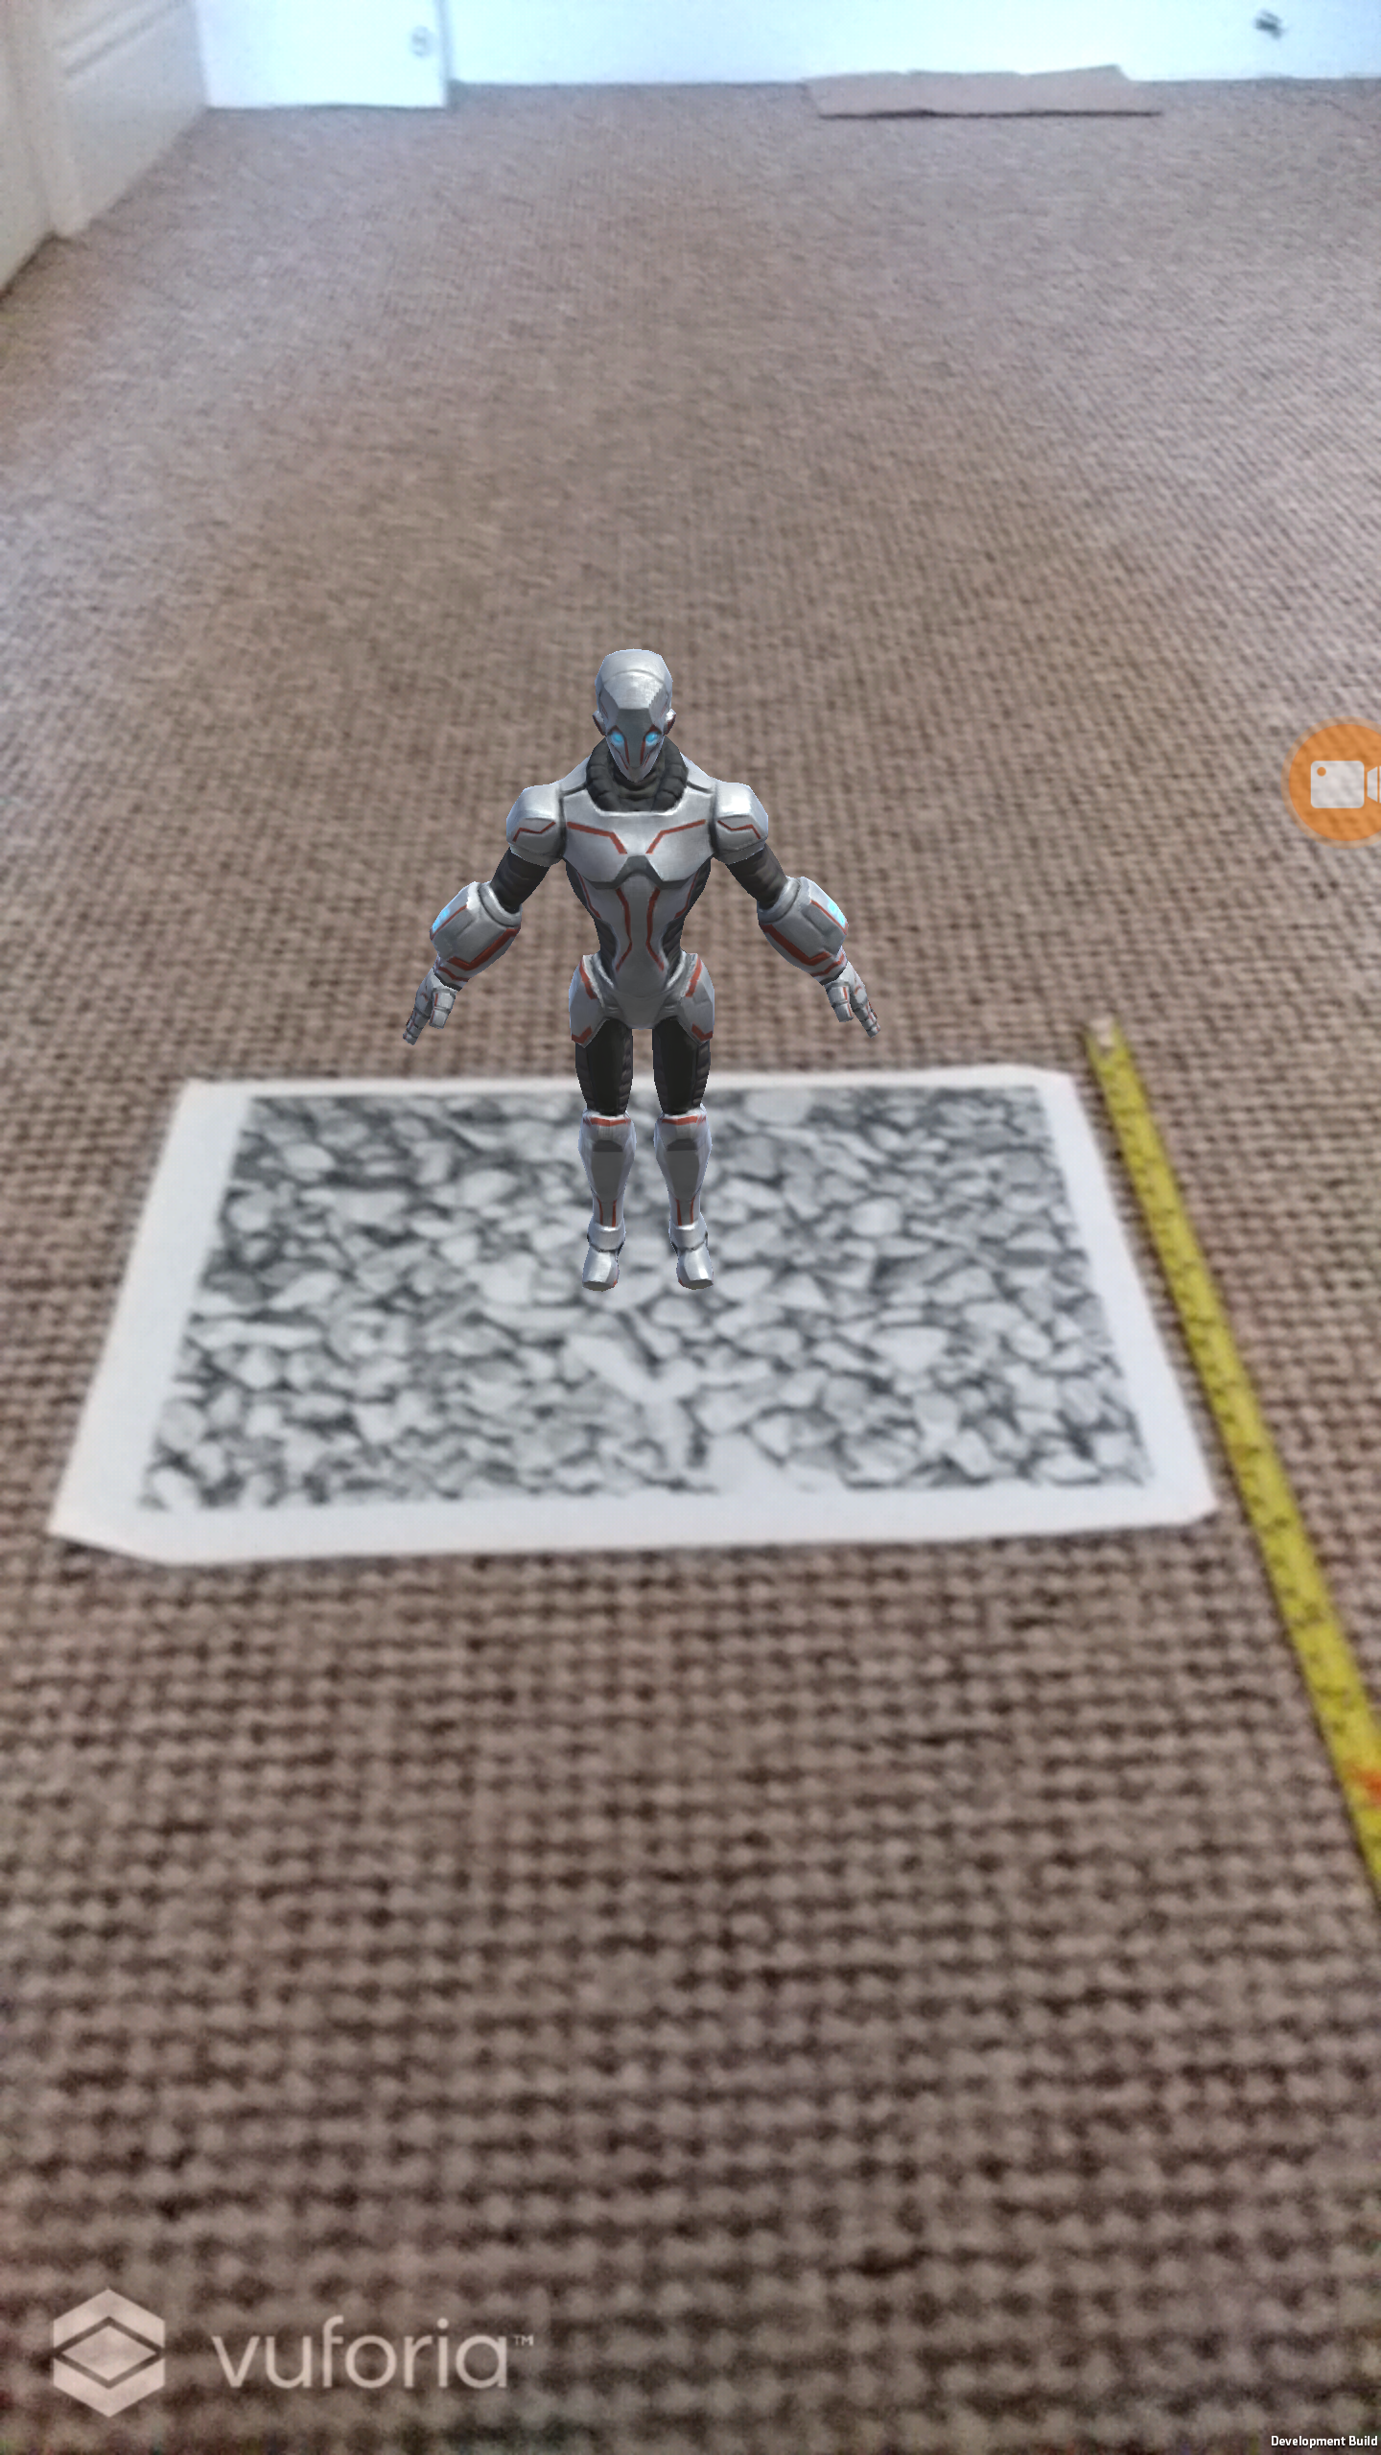
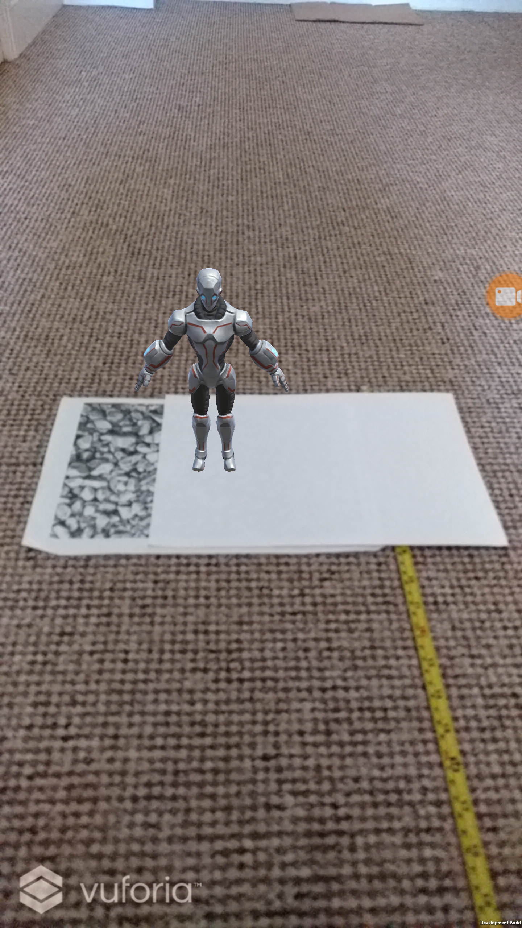



Locking and Overlapping in Augmented Reality
Dylan Tik Lun Chan
Bachelor of Science (Honours) Computing with Games Development
Abstract
Augmented Reality (AR) allows the user to display virtual objects to the real world environment. Marker-based AR and Marker less AR are techniques to display virtual objects.
Objective
The objective of this investigation was to analysis locking and overlapping in Augmented Reality (AR) using marker-based and marker less AR technique.
Methods
This was accomplished using Unity 3D game engine and Vuforia software development kit (SDK). Vuforia have different types of marker based techniques.
Vuforia User Defined Targets
Vuforia Image Targets
Object overlapping the Image Target
AR Objects
AR Objects
Object overlapping the Image Target
Target that the AR Object appears on.
Object overlapping the Image Target
Image Target
Results
Conclusions
The locking efficiency of Image Targets is greatly effected if the distance from Image Target is greater than 1.5 metres.
The locking efficiency of User Defined Targets is greatly effected if the distance from target is greater than 2.4 metres.
Overlapping an AR object using both Image Targets and User Defined Targets techniques are very efficient it can still detect and lock onto AR object even when the target area is 70-80% covered.
Vuforia User Defined Targets can lock onto four objects at the same time.
For the best locking efficiency for Vuforia Image Targets (Marker Based AR) 1.5 metres.
For the best locking efficiency Vuforia User Defined Targets is and 2.4 metres.
Both Image Targets and User Defined Targets are very efficient.
Vuforia User Defined Targets cannot lock onto more than four objects at the same time.

